Slide 1




Project Progress Presentation - I
on
Web3 & Blockchain based Decentralized Social-Connectivity web application
Under the guidance of
Mr. Pravin Kumar Pandey
(Assistant Professor)
Dept. of Computer Science and Engineering
Presented by
Mili Srivastava(205433)
Rachit Bharadwaj(205445)
Dept. of Information Technology
Department of Information Technology
UNSIET VBSPU Jaunpur

Slide 2

Contents
Introduction
Aim
Objectives
Methodology
Objectives Accomplished in Development phase
Future Steps
Conclusion

Slide 3

Introduction
Our project endeavours to reshape social media through Web3 technologies. By leveraging blockchain, smart contracts, and decentralized storage, we aim to create a user-centric platform that prioritizes ownership, transparency, and security.
Our vision is to offer users control over their data, transparent content moderation, and a decentralized architecture that mitigates censorship.

Slide 4
Aim
Our primary aim is to develop a decentralized social media platform that addresses the limitations of traditional centralized platforms, focusing on user ownership, transparency, and censorship resistance.

Slide 5
Objectives
Research to define project goals and requirements for decentralized social media.
Design technical infrastructure prioritizing scalability, security, and interoperability.
Develop infrastructure emphasizing scalability, security, and interoperability, with prototypes for visualization.
Advance project with frontend, backend, and database development, including smart contract deployment.
Prepare for deployment by configuring infrastructure, deploying contracts, and implementing marketing strategies.

Slide 6

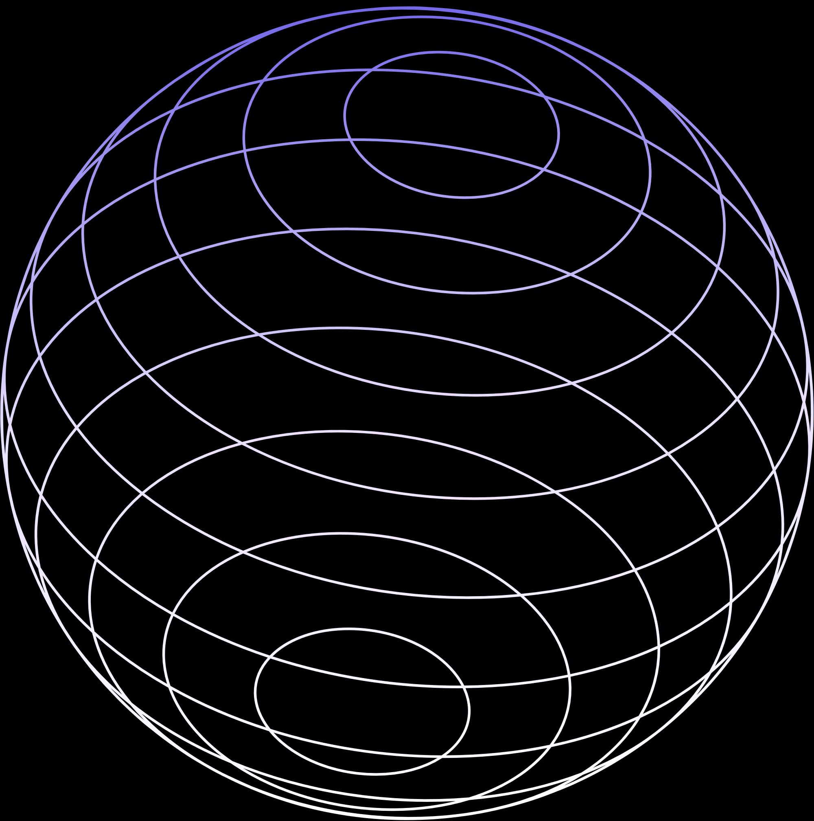
Methodology
Research & Planning: Explore Web3 technologies and define project objectives.
Frontend Development: Design and implement UI/UX components using Next.js.
Smart Contract Development: Write Solidity contracts for platform functionalities.
Blockchain Integration: Deploy contracts on Ethereum and integrate with frontend.
IPFS Integration: Set up IPFS for decentralized file storage and integrate with frontend.
Database Integration: Use MongoDB for structured data management.
Testing & QA: Write tests for reliability and conduct user acceptance testing.
Deployment & Maintenance: Deploy on cloud platforms and provide ongoing support.

Slide 7
Demo
Blockchain Demo
https://tools.superdatascience.com/blockchain/block
Smart Contracts Demo
https://remix.ethereum.org/#lang=en&optimize=false&runs=200&evmVersion=null&version=soljson-v0.8.24+commit.e11b9ed9.js

Slide 8
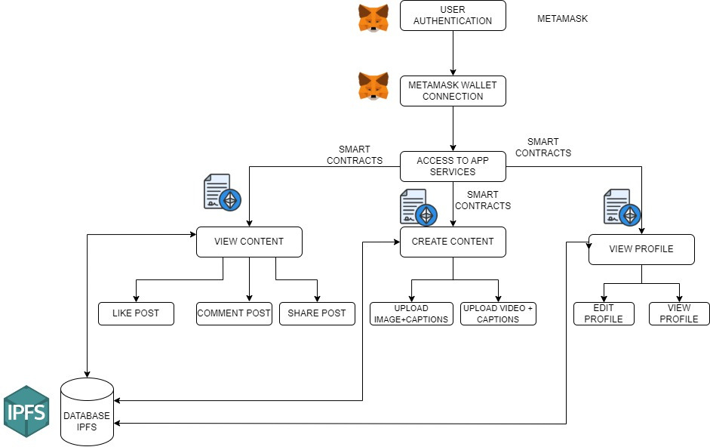

Slide 9
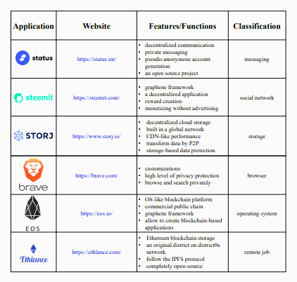
Several representative products in Web 3.0

Slide 10
Ojectives Accomplished in Development phase
01
02
03
Designed and developed user-friendly interfaces using Next.js, ensuring seamless navigation and interaction.
Successfully developed smart contracts for the Ethereum blockchain to handle core functionalities related to user and posts.
Created and integrated database to store the user and posts related data.

Slide 11

Future Steps
Backend Development: Creating a secure backend to implement the smart contracts and integrate it with the frontend.
Decentralized Storage Integration: Integrate IPFS for decentralized storage of media files, enhancing data security and reducing reliance on centralized servers.
Scalability Optimization: Optimize backend infrastructure for scalability, ensuring seamless performance as user base and data volume grow.

Slide 12
Conclusion
In conclusion, our project has made solid progress in building a decentralized social media platform. We've successfully designed and implemented the frontend, created smart contracts for Ethereum integration and created and integrated the database.
However, we still need to deploy the smart contracts by creating a backend for it and actively do the data management. Our next steps will focus on these tasks to fully realize our goal of a decentralized social media experience.

Slide 13

Thank you very much!

